Slide 1
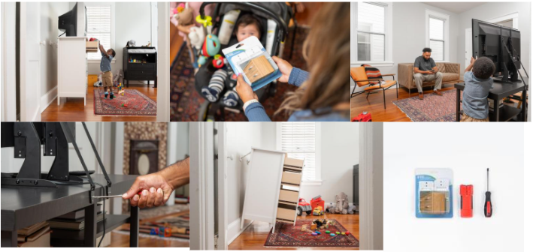
Collaborator Toolkit

Slide 2
Table of Contents
Messaging……………………………3
PSA Videos……………..……………….7
How to Anchor ……………………10
Social Media……………………..…12
Visual-Logo Library…..………….18
Resources…………………………….21
Contact Information………….…24

Slide 3
MESSAGING
Anchor It! Collaborator Toolkit

Slide 4
Anchor It! Campaign Messaging
Please feel free to use these campaign messages when writing about or discussing Anchor It!:
Anchor It! is a national public education campaign from the U.S. Consumer Product Safety Commission (CPSC).
CPSC launched its Anchor It! campaign in 2015, in collaboration with families who have experienced tip-over incidents, to help other families avoid the dangers of falling furniture and TVs.
The campaign aims to educate consumers about the hazards associated with furniture, TV and appliance tip-overs.
Rates of injury and fatalities from tip-overs are higher than most people could imagine. Since 2000, there have been 581 tip-over fatalities involving furniture, TVs, or appliances.
Anchor It! promotes how-to guides for life-saving preventative actions for consumers.
The campaign also works with many manufacturers to encourage them to provide anchors with their products, and with home improvement stores and websites to carry affordable anchoring kits.

Slide 5
Anchor It! Messaging – Essential Steps
CPSC urges all adults to take essential steps to protect their families from dangerous tip-over risks:
Anchor TVs and furniture, such as bookcases and dressers, securely to the wall.
Always place TVs on a sturdy, low base, and push the TV back as far as possible, particularly if anchoring is not possible.
Avoid displaying or storing items, such as toys and remotes, where kids may be tempted to climb to reach for them.
Store heavier items on lower shelves, or in lower drawers.
If purchasing a new TV, consider recycling older ones not currently in use. If moving the older TV to another room, be sure it is anchored to the wall properly.
Keep TV and cable cords out of reach of children.
Even when TVs and furniture are anchored, adult supervision is still recommended.

Slide 6
2021 Tip-Over Data & Messaging
In 2022, CPSC released the following data via its annual “Product Instability or Tip-Over Injuries and Fatalities Associated with Televisions, Furniture, and Appliances: 2021 Report.”
Since 2000, there have been 581 tip-over fatalities involving furniture, TVs, or appliances, of which 472 were children (81%, ages 17 years and younger).
From 2011 to 2020, there has been a 55% decrease in all emergency department-treated, tip-over injuries among all ages. This decline in the estimated overall number of injuries is largely due to the decline in tip-over injuries involving a TV.
71% of child fatalities involve a TV alone or furniture and a TV together. A TV falling from an average-sized dresser delivers a force of several hundred pounds.
55% of fatalities involved people being crushed.
66% of fatalities were caused by head injuries.
91% of reported tip-over fatalities occurred inside a home.
45% of all fatalities involving children occurred in bedrooms, with the next closest – 19% – in living/family rooms.
72% of child fatalities involved climbing or the application of force.
27% of child fatalities were reported as unknown scenarios, which commonly happened when the child was alone in a room.

Slide 7
PSA VIDEOS
Anchor It! Collaborator Toolkit

Slide 8
PSA: “Even When You’re Watching”
To illustrate the risks of tip-overs, Anchor It! has created several public service announcement (PSA) videos. They can be viewed in English and Spanish.
Our most recent PSA, “Even When You’re Watching,” includes real footage of tip-overs caught on tape. It debunks the common myth that watching children is a substitute for anchoring TVs and furniture. While the children in this PSA were not harmed, many others are not as fortunate.
Watch and share the full PSA using the links below:
English: https://bit.ly/3uV45de
Spanish: https://bit.ly/3qYcKdG

Slide 9
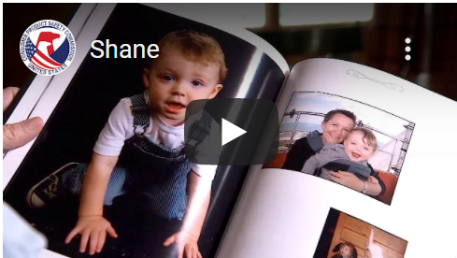
Other PSA Videos
In addition to “Even When You’re Watching,” parents of children who died from a furniture or TV tip-over speak in another series of videos, urging others to act. They share just how real and dangerous falling TVs and furniture like dressers, bookcases, and nightstands can be to children.
Watch and share the full PSA videos, using the links below:
Real Moms Urge Parents to Anchor It: https://bit.ly/3Miwm4z
Shane: https://bit.ly/397s9Cz
Chance: https://bit.ly/36LBrDz
Meghan: https://bit.ly/3NGjTJH

Slide 10
HOW TO ANCHOR
Anchor It! Collaborator Toolkit

Slide 11
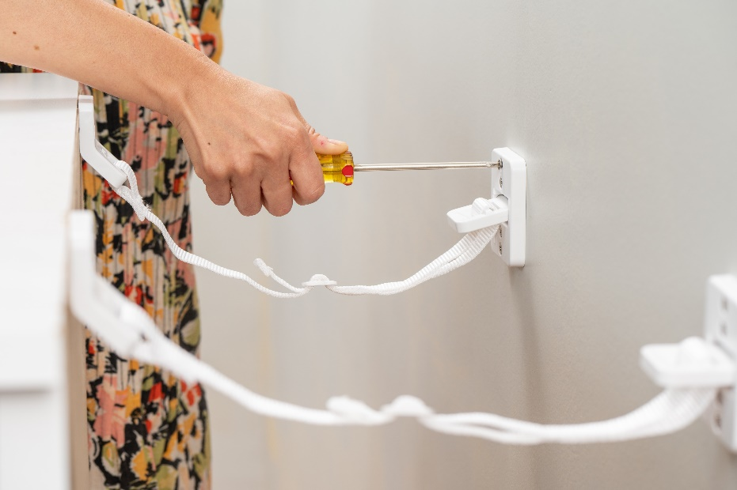
How to Anchor
CPSC’s Anchor It! campaign website outlines three simple steps designed to reduce the risk of a tip-over incident.
The steps are as follows:
Get the Stuff: What You’ll Need
Get it Done: How to Install Kit
Get it Secured: Tug on the straps to be confident everything is secure. Share your experience with others to keep kids safe!
The website also includes repair tips for homeowners moving, renting or redecorating.
In addition, the campaign has also shared an instructional video that outlines the three simple steps detailing how consumers can secure their furniture from tip-over incidents.

Slide 12
SOCIAL MEDIA
Anchor It! Collaborator Toolkit

Slide 13
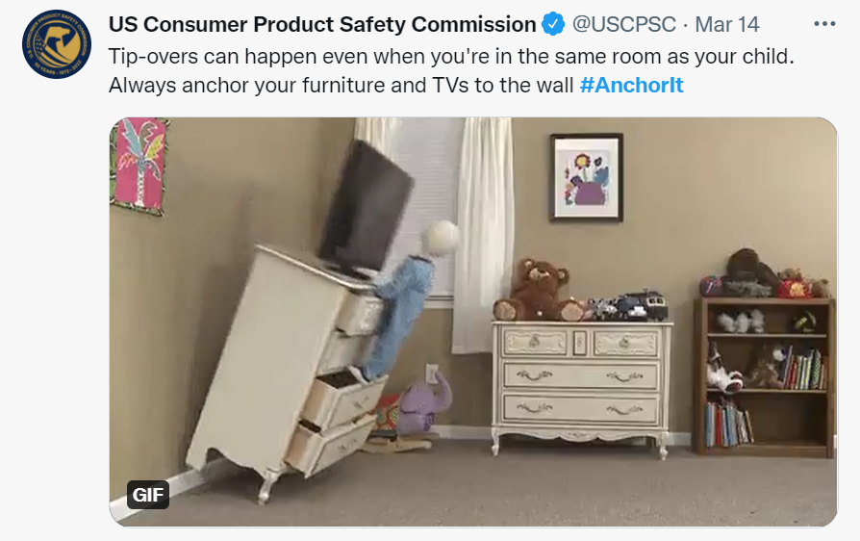
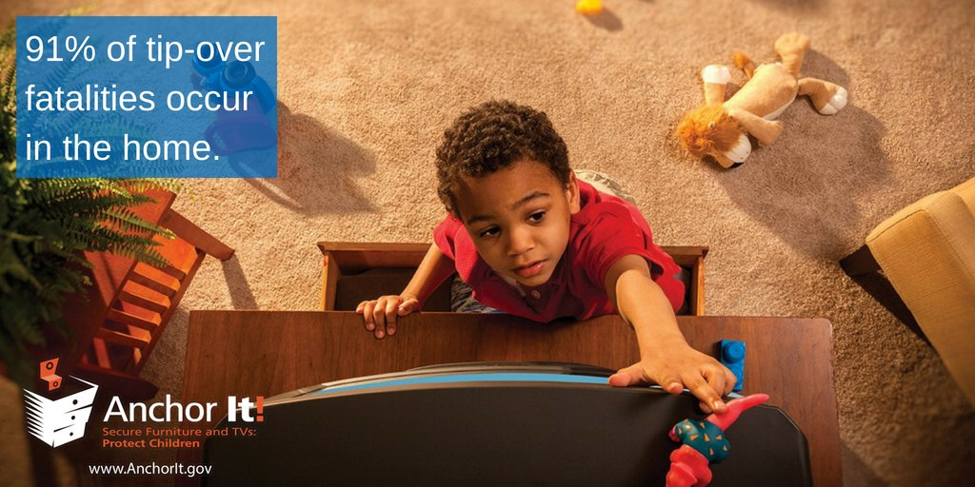
Anchor It! Hashtags
Campaign hashtags to use when posting about Anchor It! on social media:
English:
#AnchorIt
#TipOvers
#StopTipOvers
#FurnitureTipOvers
#TVTipOvers
#EvenWhileYou’reWatching
Spanish
#Asegúrelos

Slide 14
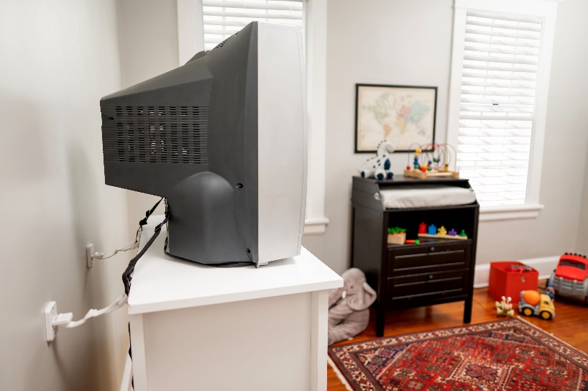
Sample Social Media Posts: Twitter
Please feel free to share any of these sample posts on your Twitter account- or write your own using these as a guide!
Tip-overs can happen even when you're in the same room as your child. Always anchor your furniture and TVs to the wall #AnchorIt #EvenWhileYou’reWatching: https://bit.ly/3uV45de
If you’re buying a new TV this week, make sure you purchase tip-over straps as well. #AnchorIt #StopTipOvers: https://bit.ly/3r27c26

Slide 15
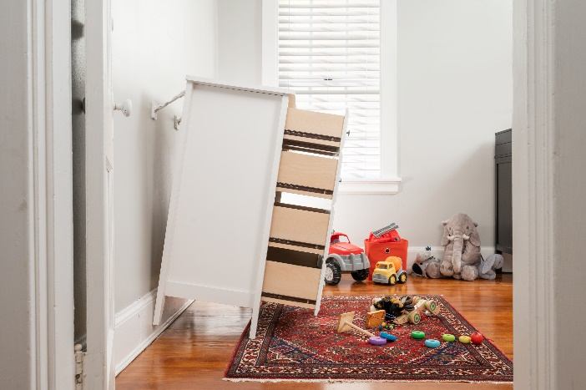
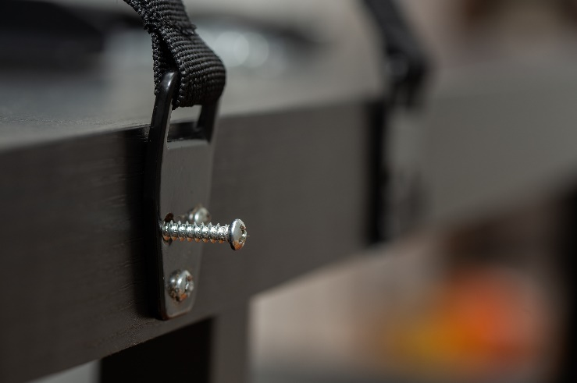
Sample Social Media Posts: Instagram
TVs and furniture can fall faster than you realize and tip-over incidents can happen even when you're in the same room as your child. Protect your children - always #AnchorIt.
Many caregivers think they don’t need to anchor their furniture because they “watch their kids”. The truth is, even when you’re watching, you’re not faster than a falling dresser. Always #AnchorIt. Link in bio to learn more.

Slide 16
Sample Social Media Posts: Facebook
Feel free to share any of the below posts on your Facebook page – or write your own using these as a guide!
If you’re planning on buying a new tv anytime soon, make sure you purchase a tip-over kit with it! Anchoring your TV and furniture is an important way to make sure your kids stay safe at home. Anchor kits are inexpensive and easy to install. Learn more at: www.anchorit.gov.
Most tip-over kits cost less than $20 and take fewer than 20 minutes to install. Learn more about how you can easily secure your furniture and keep your kids safe at home here: https://bit.ly/3r27c26

Slide 17
Sample Social Media Posts: Spanish
Si su audiencia habla español, comparta cualquiera de las siguientes publicaciones en sus redes sociales, o escribe sus propias publicaciones utilizando estos como guía.
Twitter: Los muebles y televisores pueden caerse sobre los niños incluso cuando los está viendo. Proteja a sus hijos. Para más información, visite https://www.anchorit.gov/ #Asegúrelos
Instagram: Algunas personas piensan que no necesitan asegurar sus muebles porque “están viendo a sus hijos.” Lo cierto es que, aun estando con un adulto, los accidentes pueden ocurrir. #Asegúrelos Para más información, visite el enlace en la descripción.
Facebook: Para proteger a los niños de los riesgos relacionados con la caída de muebles, televisores y electrodomésticos, visite www.anchorit.gov/resources y adopte unas sencillas medidas de seguridad.

Slide 18
VISUAL/LOGO LIBRARY
Anchor It! Collaborator Toolkit

Slide 19
Visual/Logo Library
You can include any of these English or Spanish logos or images in social media posts, newsletters or on your website (Please be sure to attribute them to Anchor It!).
The campaign has a library of photos related to installing anti-tip kits and awareness of tip-overs. Feel free to download images from our recently updated library and share them with your community. View more images here.

Slide 20
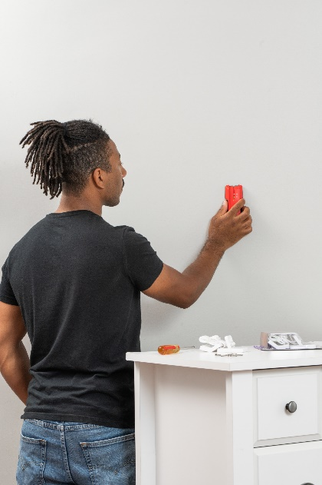
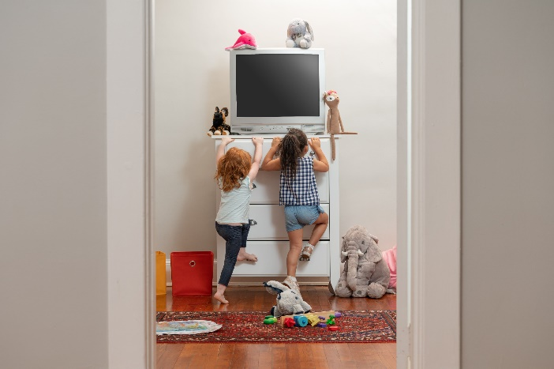
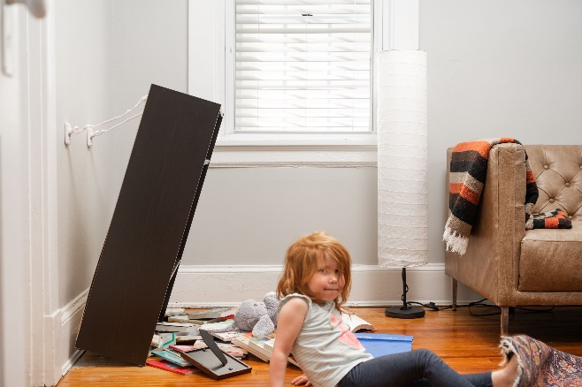
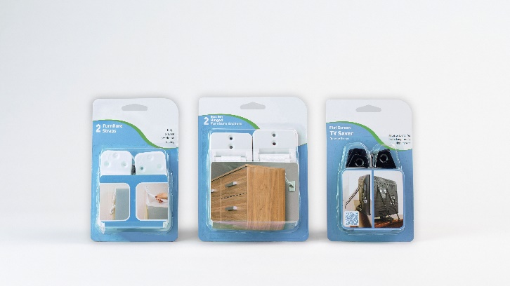
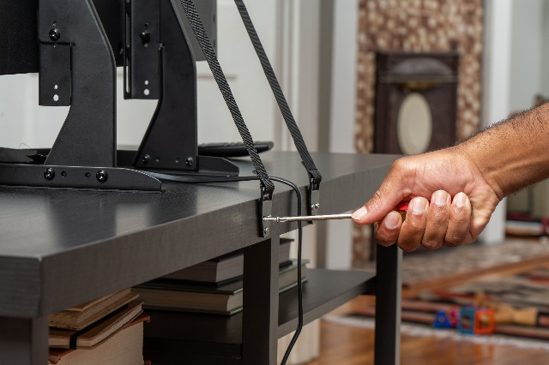
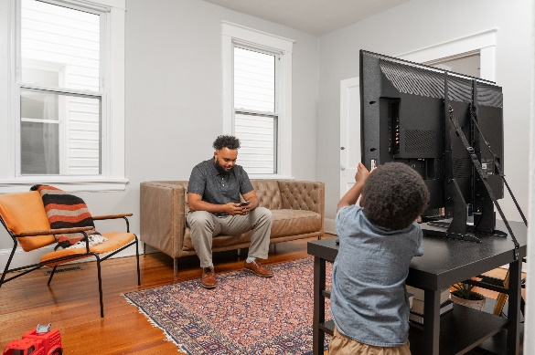
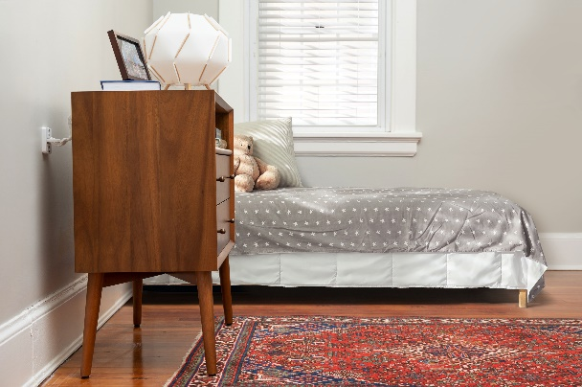
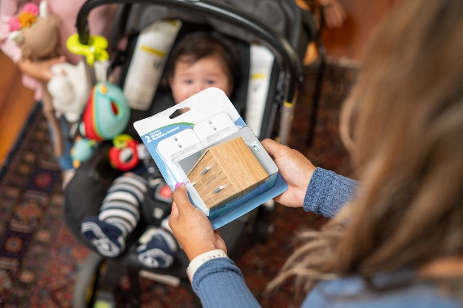

Slide 21
RESOURCES
Anchor It! Collaborator Toolkit

Slide 22
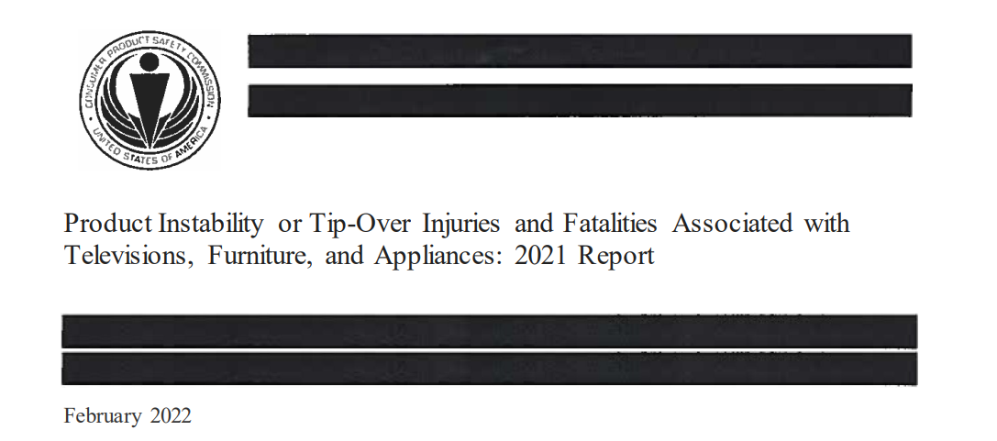
To read the latest “Product Instability or Tip-Over Injuries and Fatalities Associated with Televisions, Furniture, and Appliances” report: https://bit.ly/3NKvwiD
Latest Tip-Over Report

Slide 23
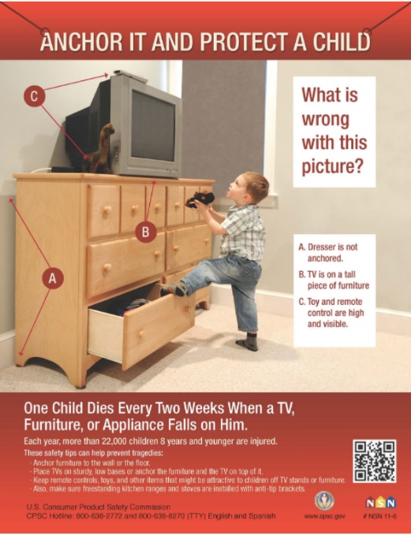
Materials Catalog
Download, in English and Spanish, brochures, tip cards, posters, videos and more through our online materials catalog: https://www.cpsc.gov/Safety-Education/Safety-Education-Materials
CPSC also provides free safety alerts, resources, posters, brochures, handbooks, and other materials you can use to spread consumer product safety information in your community. To order printed copies of CPSC’s Safety Guides, visit our Government Publishing Office page:
https://bit.ly/37bYcAe

Slide 24
CONTACT INFORMATION
Anchor It! Collaborator Toolkit

Slide 25
Keep in touch with Anchor It!
To follow CPSC on Twitter: https://twitter.com/USCPSC
To follow CPSC on Instagram: https://www.instagram.com/uscpsc/
To follow CPSC on Facebook: https://www.facebook.com/USCPSC/
To follow CPSC on YouTube: https://www.youtube.com/user/USCPSC
To report a dangerous product or a product-related injury: www.SaferProducts.gov
To email us your questions, photos and information about your tip-over safety events: kcrosswhite@cpsc.gov

